Slide 1
Basilico Family Landscape Design
Design by Serenity Scapes by Scott
March 6, 2023

Slide 2
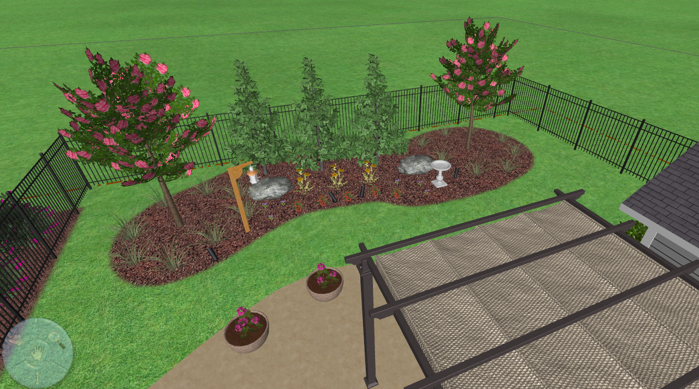

Slide 3
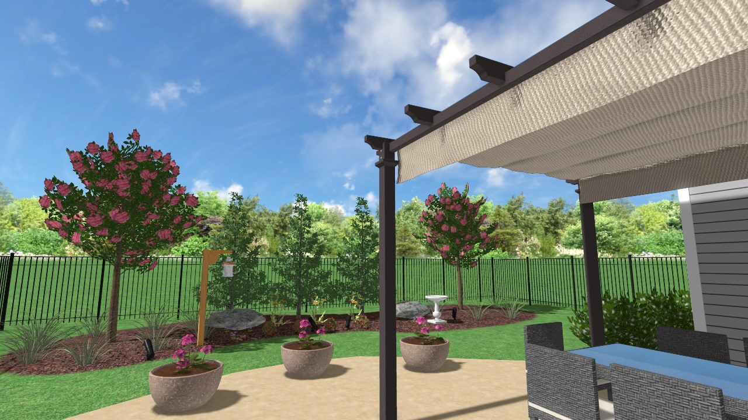

Slide 4
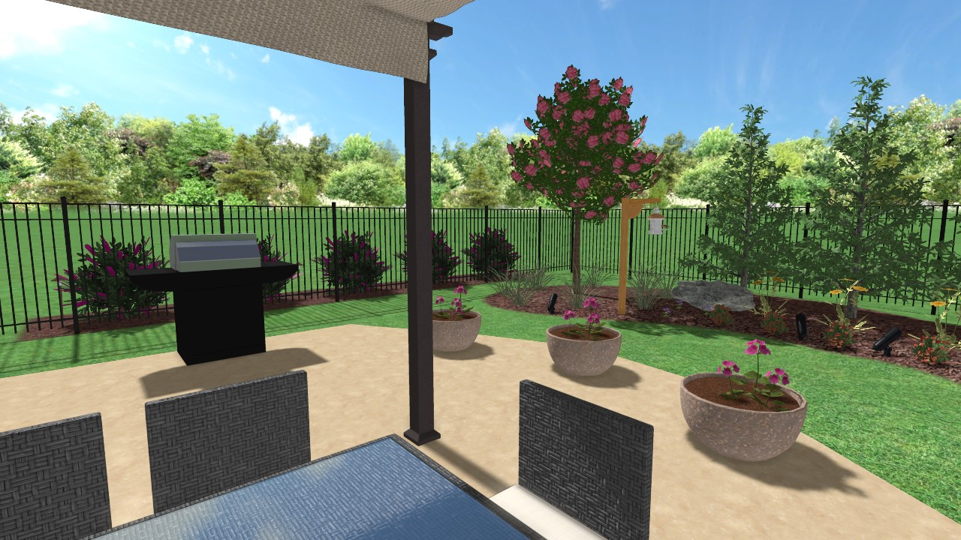

Slide 5
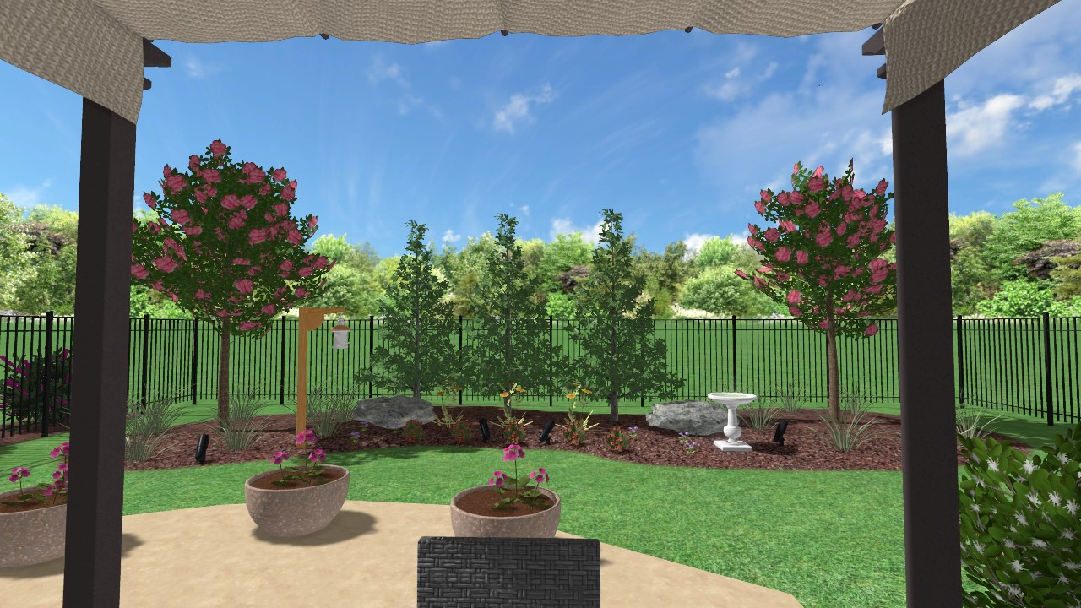

Slide 6
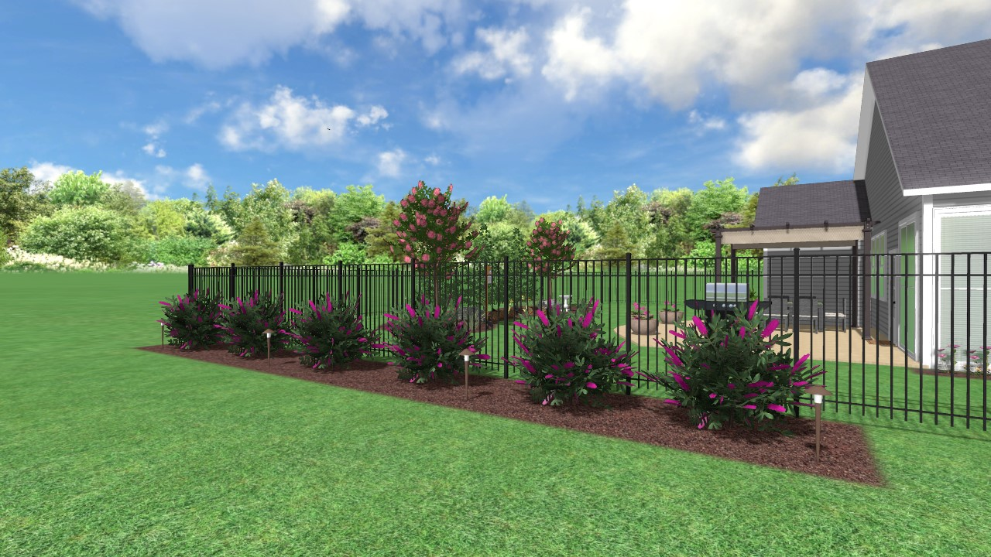

Slide 7
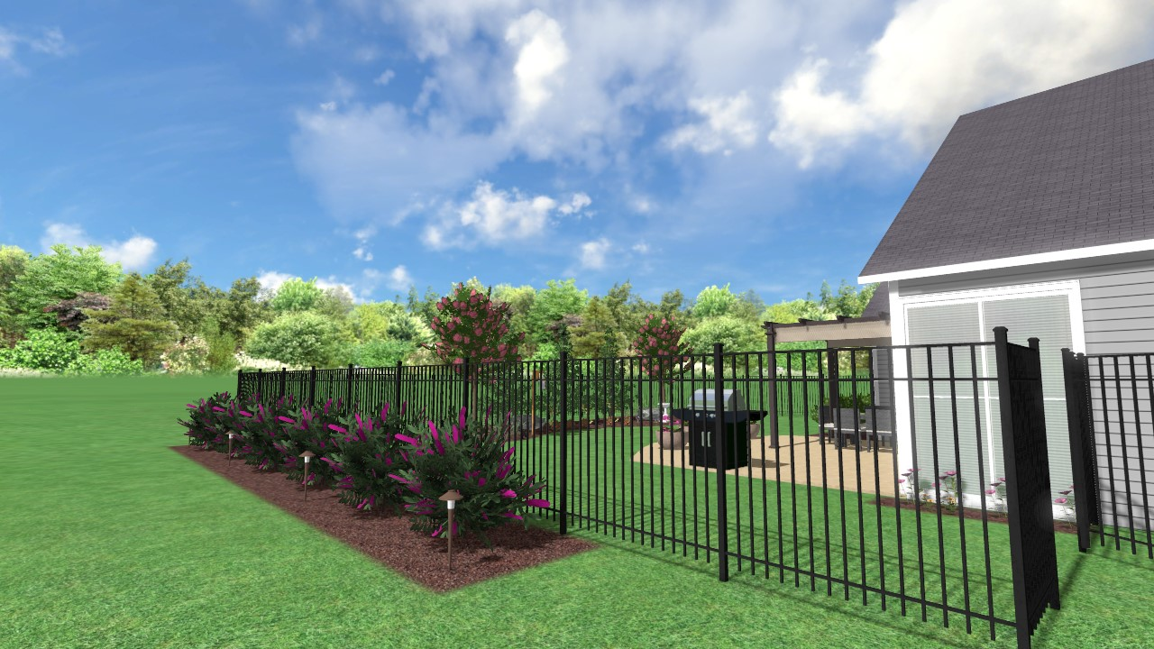

Slide 8
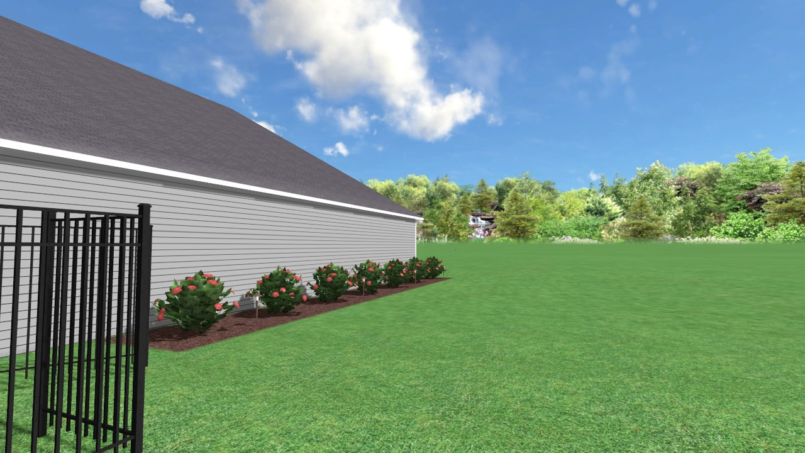

Slide 9
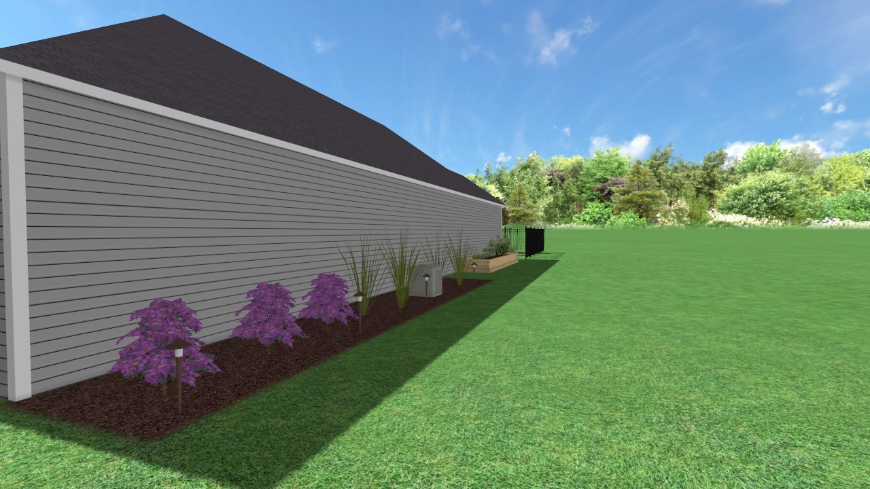

Slide 10
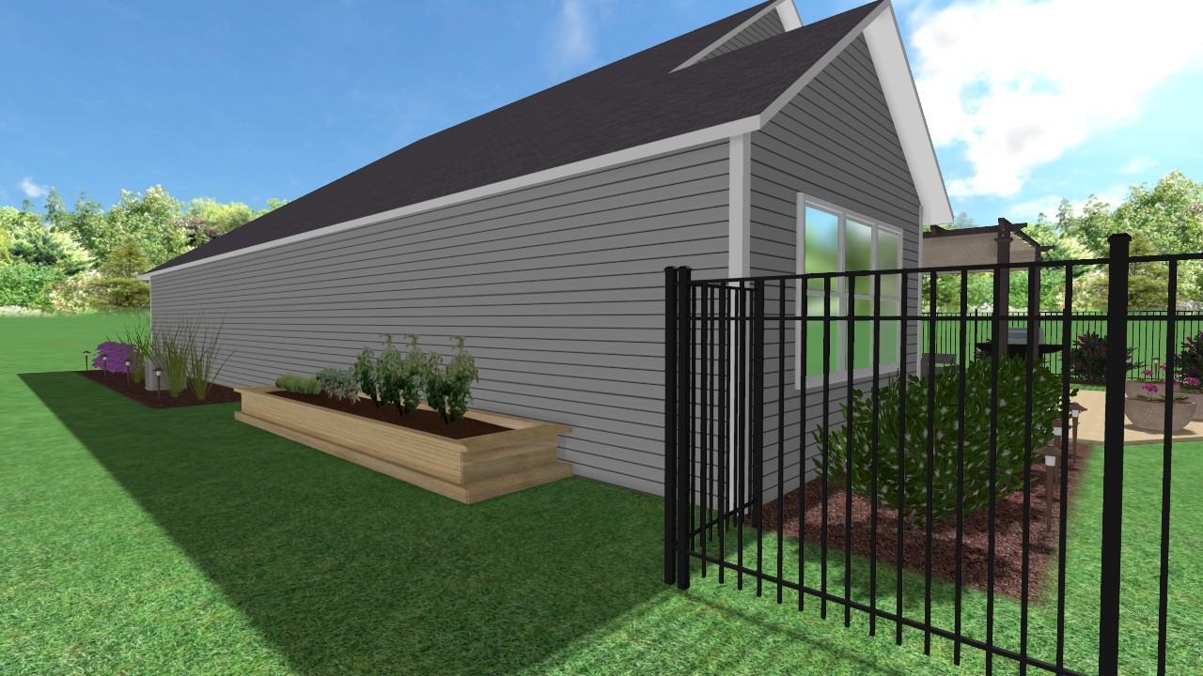

Slide 11
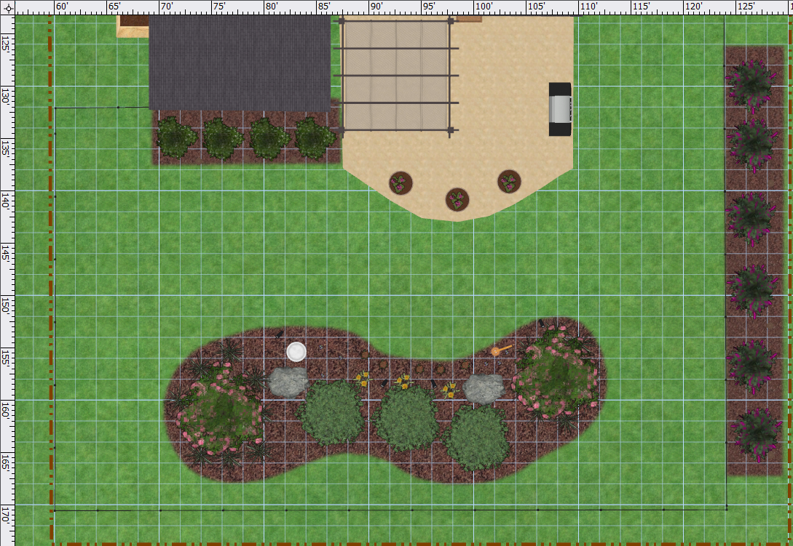
Top Down Backyard View
Purple Daydream Loropetalum (4)
Miss Molly Butterfly Bush (6)
Creeping Phlox (3)
Red Drift Roses (5)
Creeping Phlox (3)
Variegated Liriope (8)
Coreopsis (3)
Variegated Liriope (8)
Green Giant Arborvitae (3)
Biloxi Crape Myrtle (1)
Biloxi Crape Myrtle (1)

Slide 12
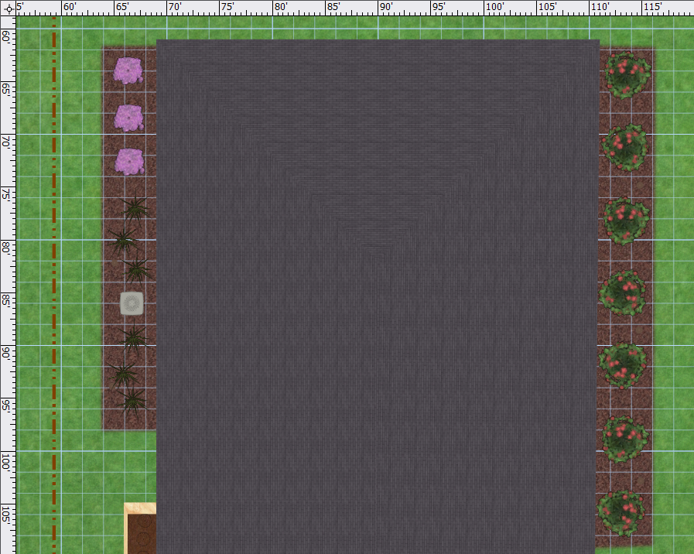
Top Down View Side Yards
Autumn Amethyst Encore Azaleas (3)
Karl Foerster Feather Reed Grass (3)
Pink Knockout Roses (7)
Karl Foerster Feather Reed Grass (3)
Vegetable Garden (Experiment – have fun!)

