Slide 1
Rust Family Landscape Design
Design by Serenity Scapes by Scott
March 22, 2023

Slide 2
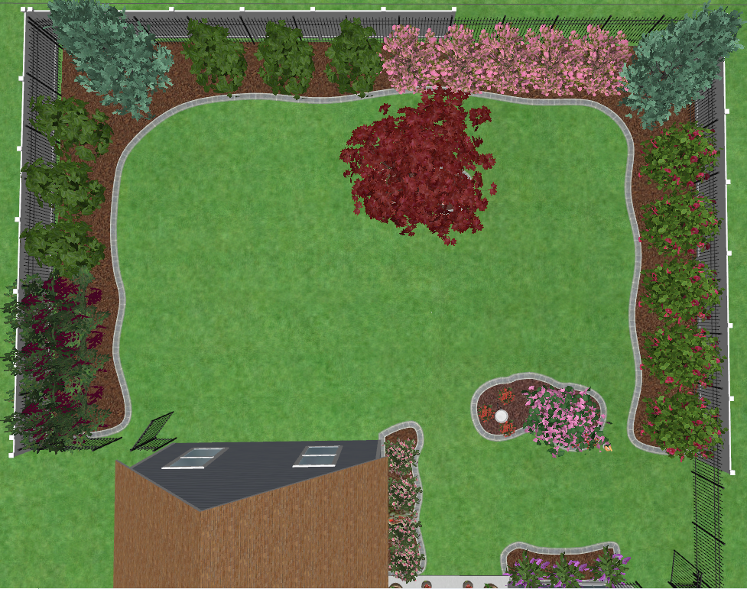

Slide 3
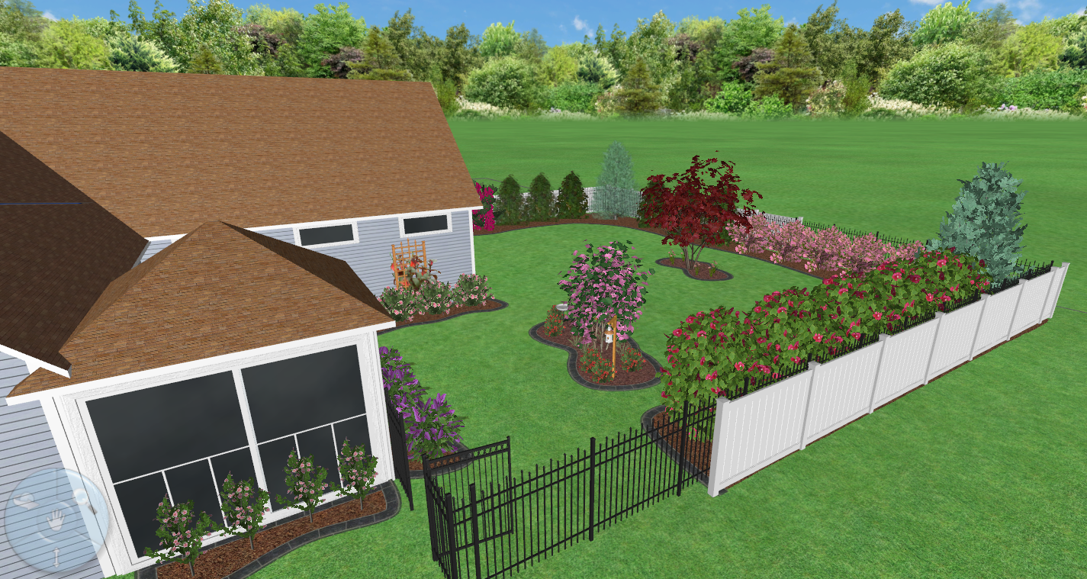

Slide 4
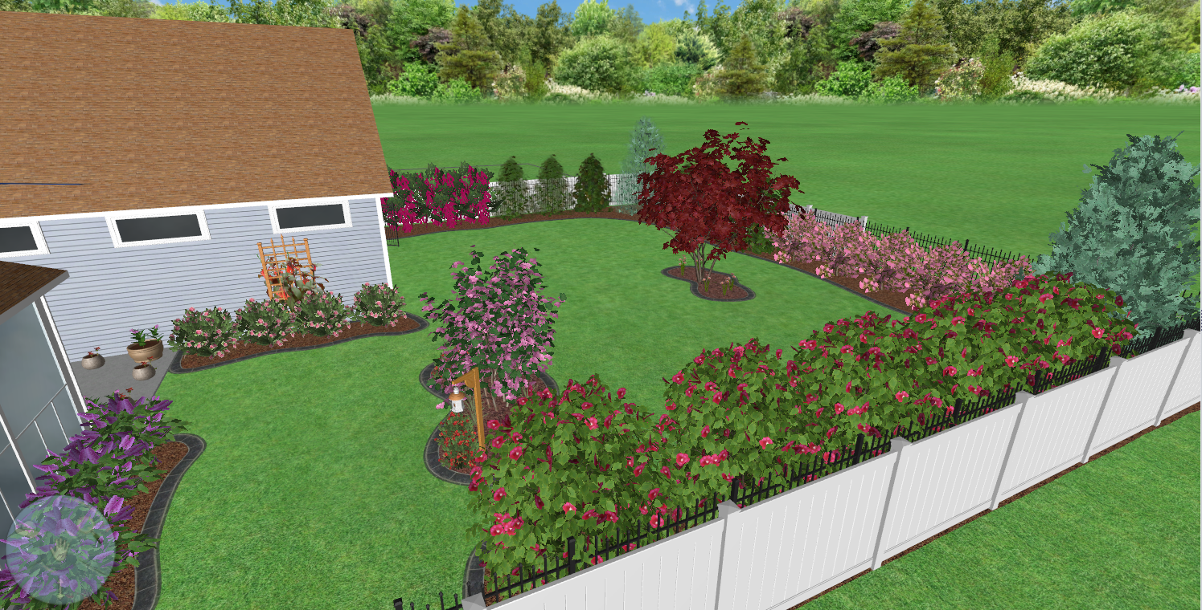

Slide 5
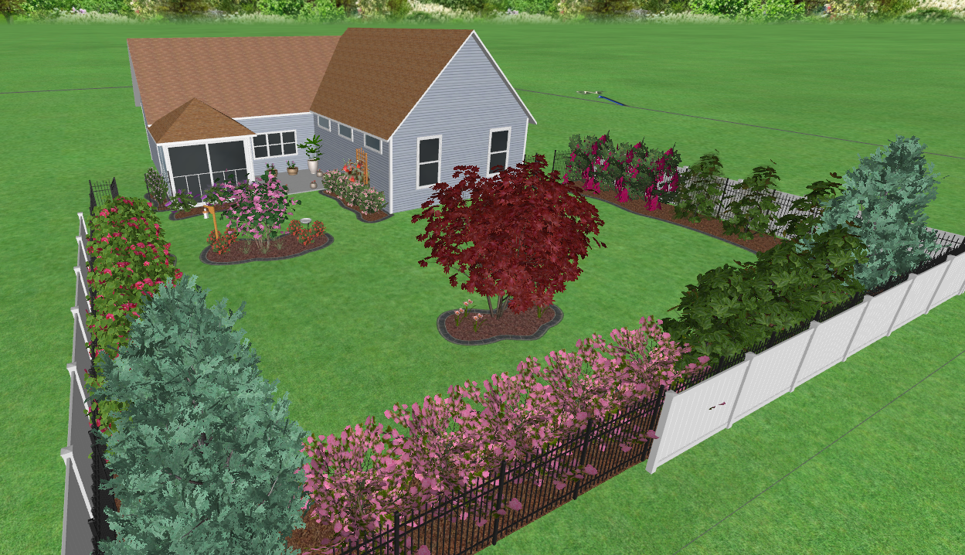

Slide 6
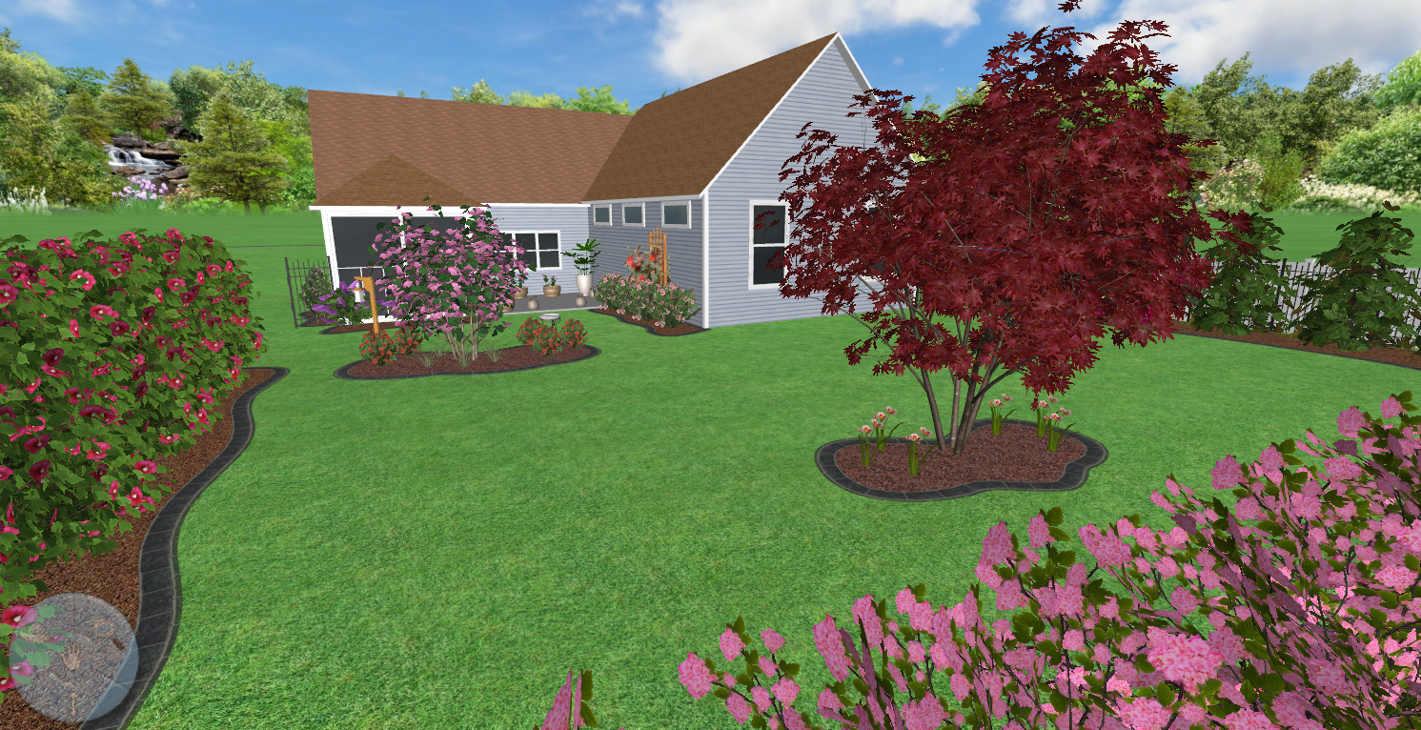

Slide 7
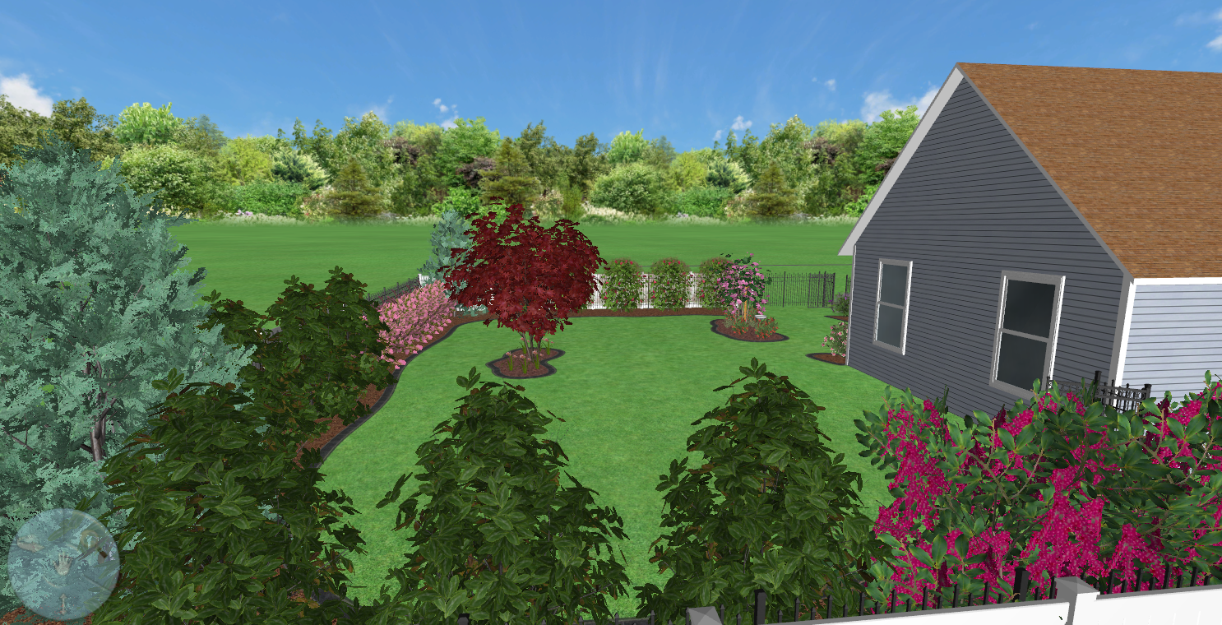

Slide 8
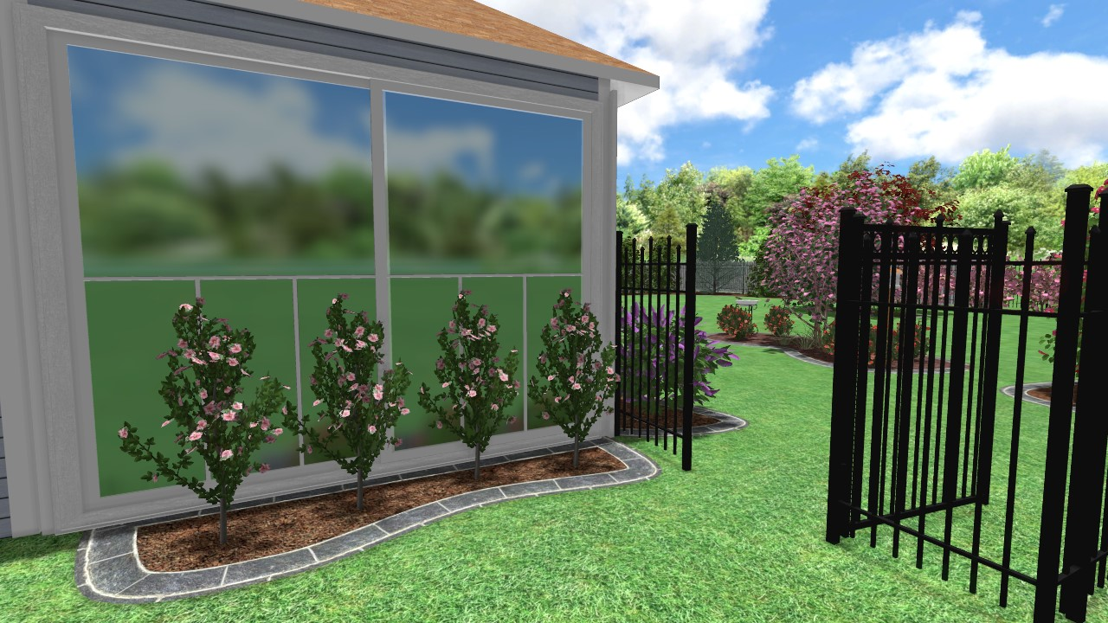

Slide 9
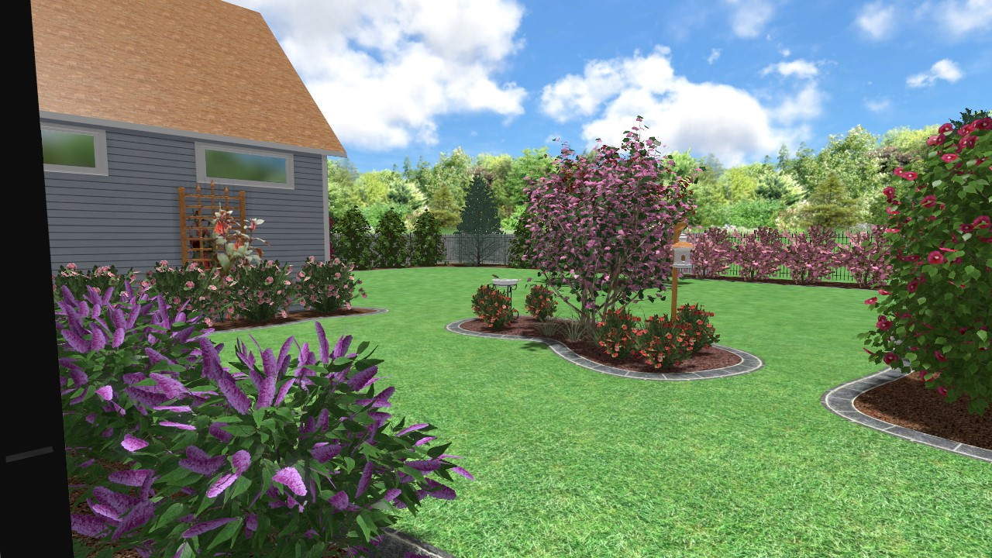

Slide 10
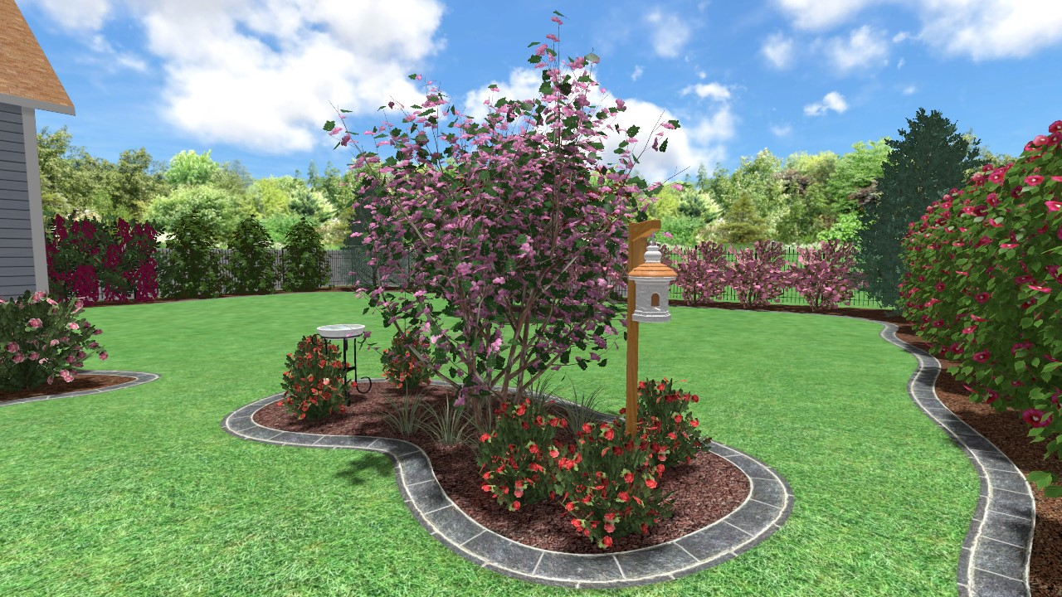

Slide 11
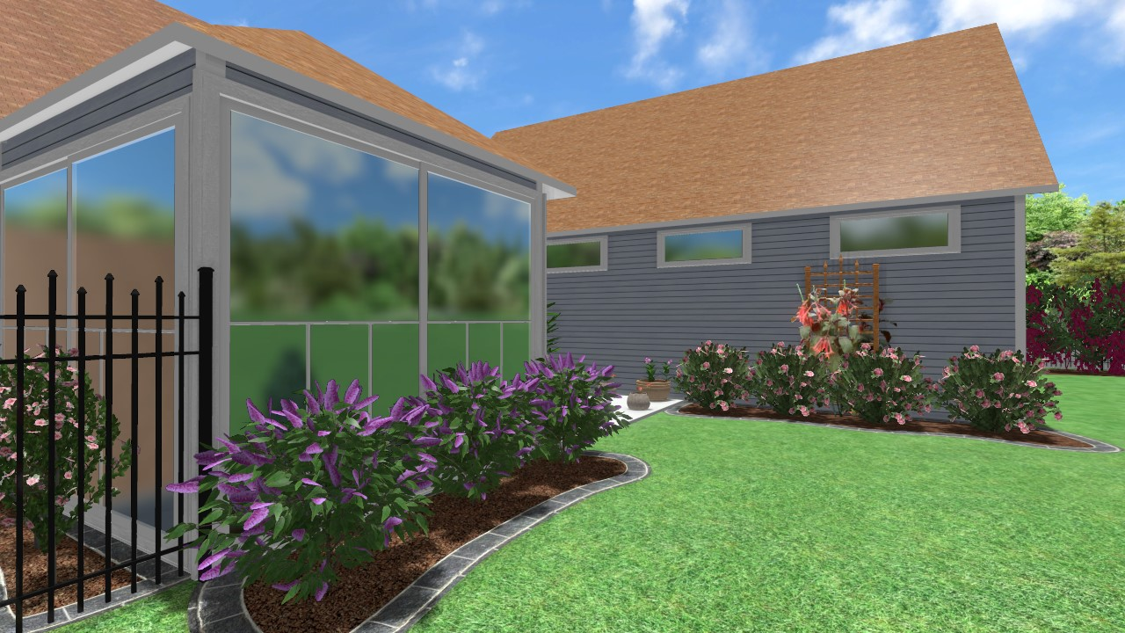

Slide 12
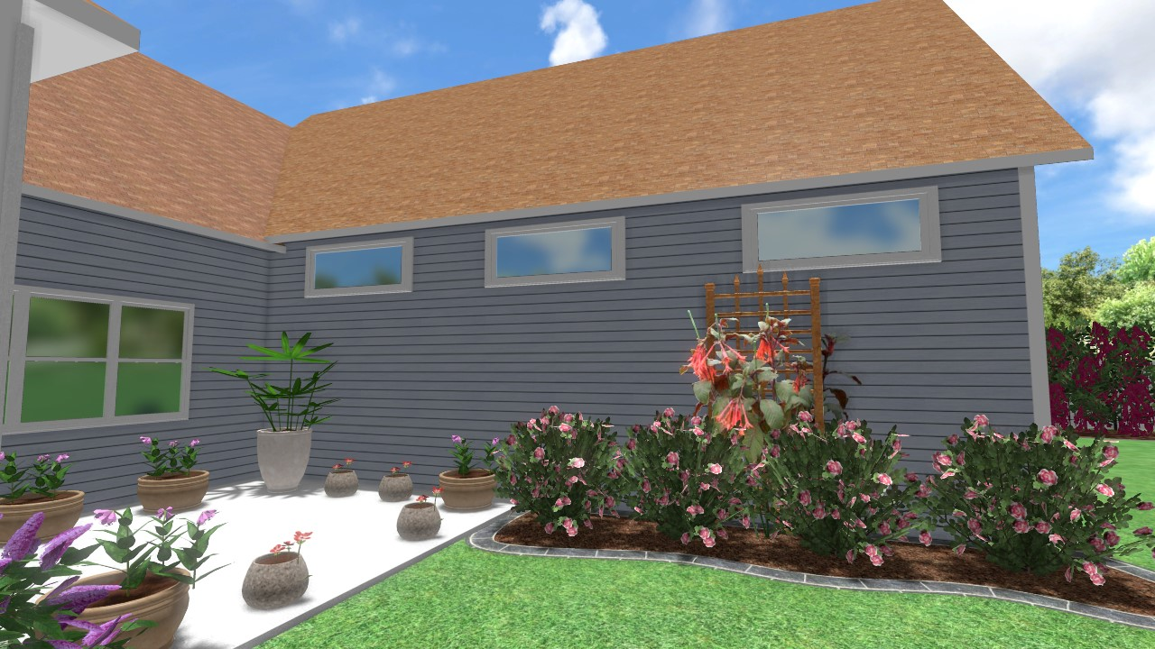

Slide 13
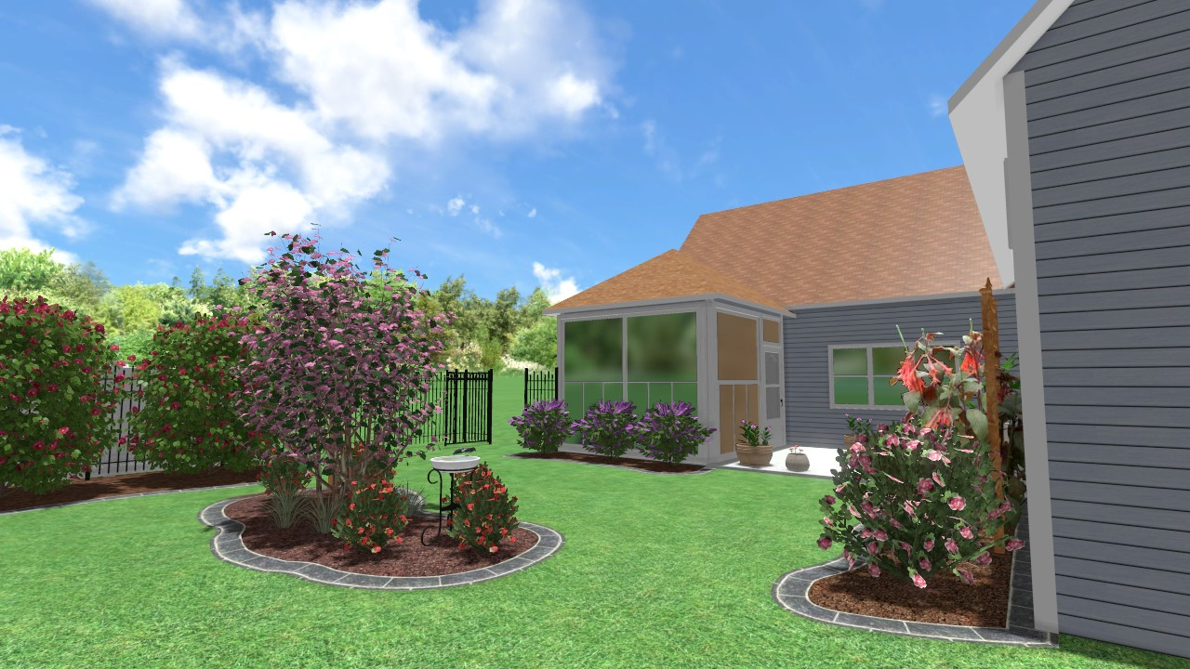

Slide 14
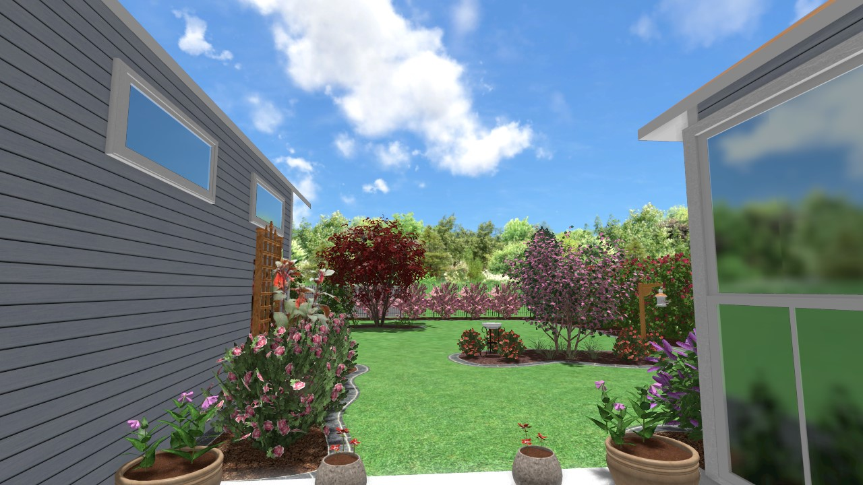

Slide 15
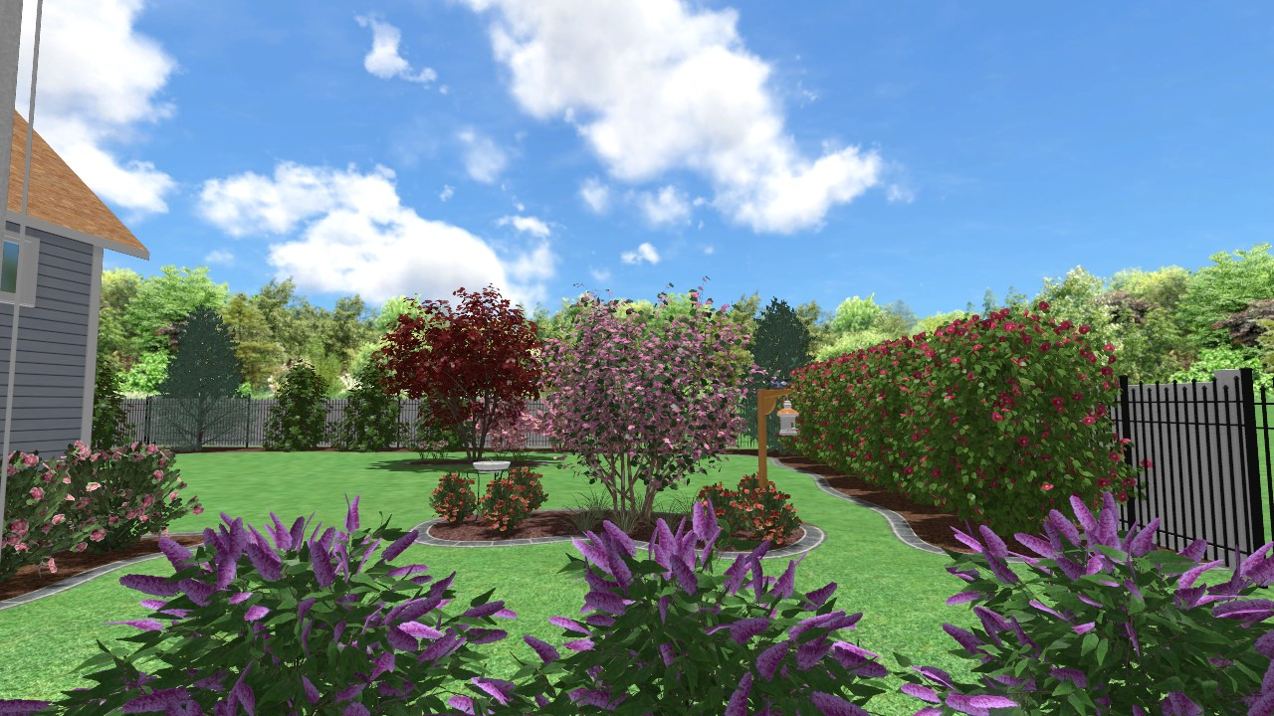

Slide 16
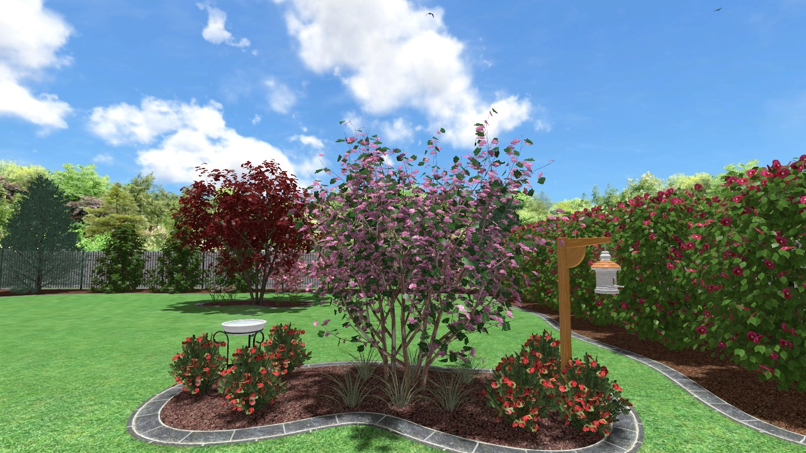

Slide 17
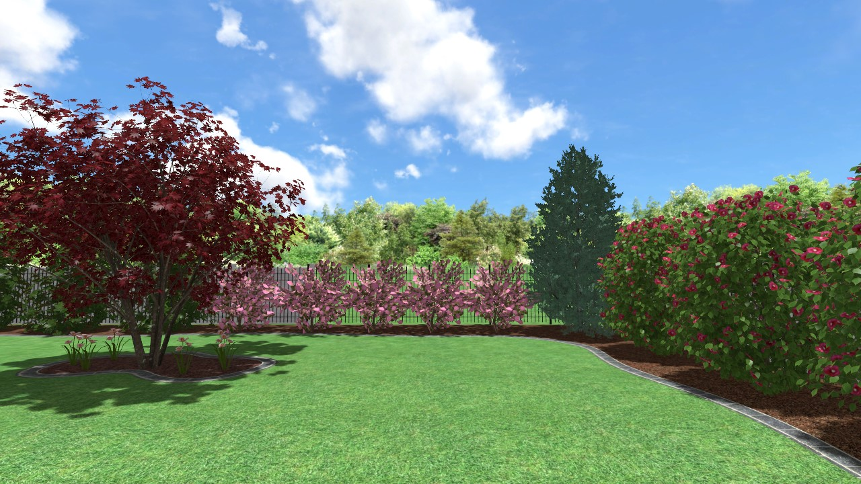

Slide 18
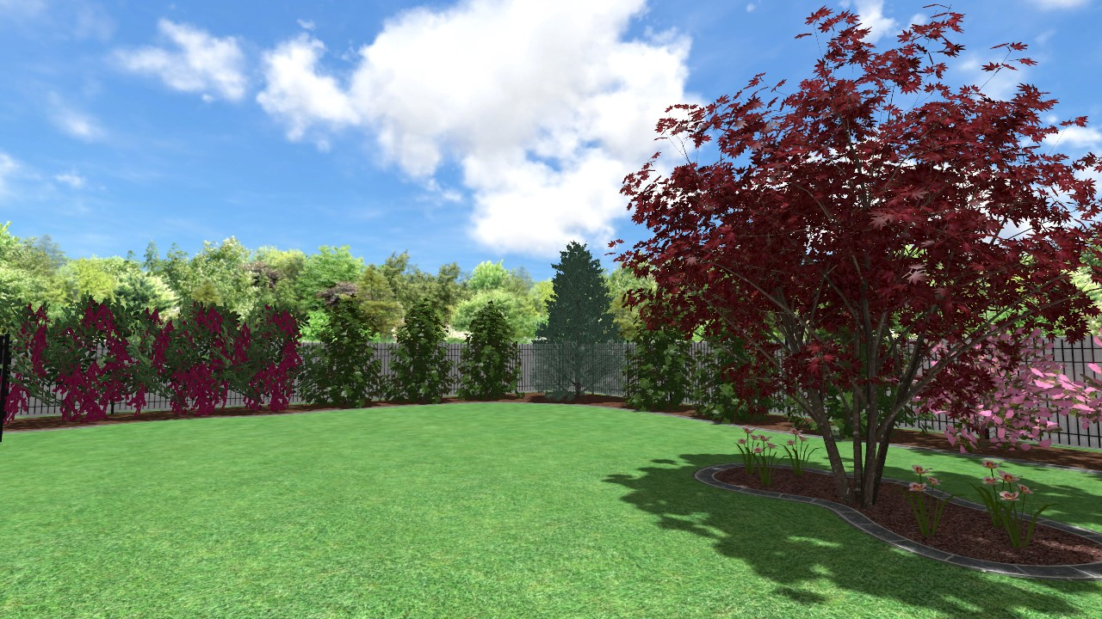

Slide 19
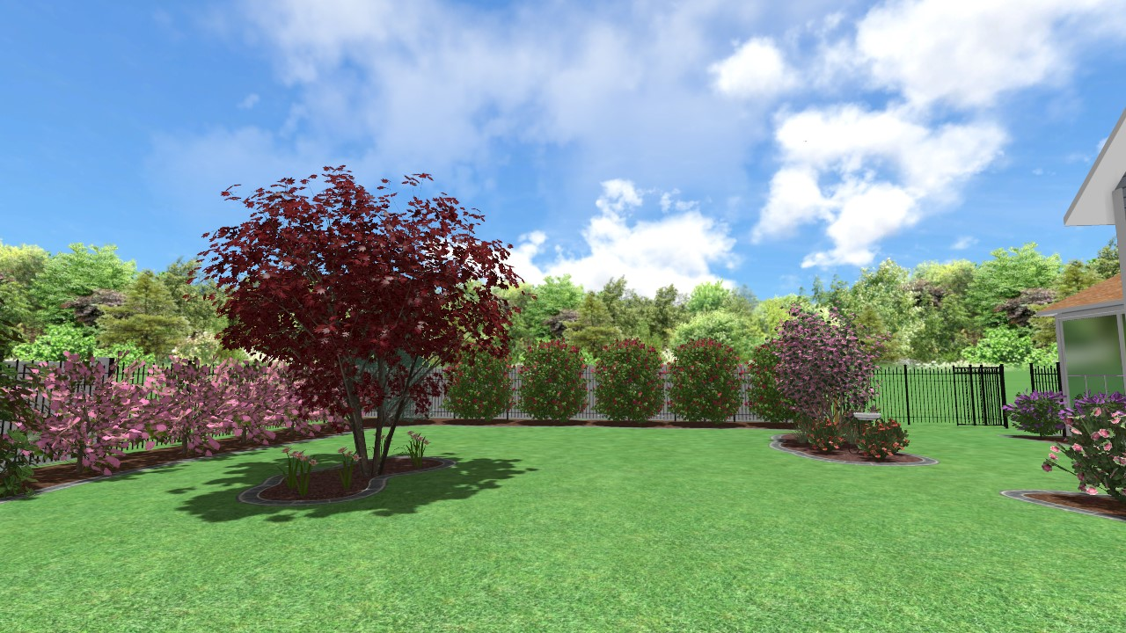

Slide 20
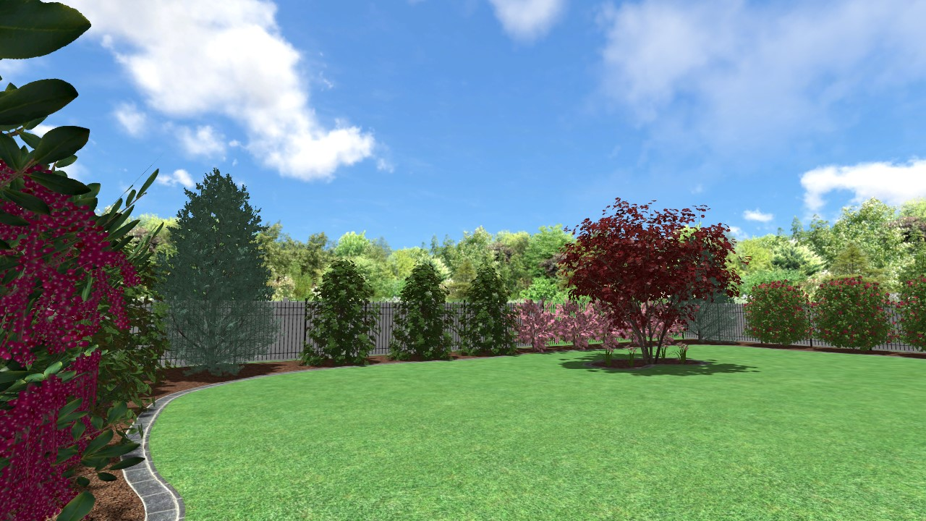

Slide 21
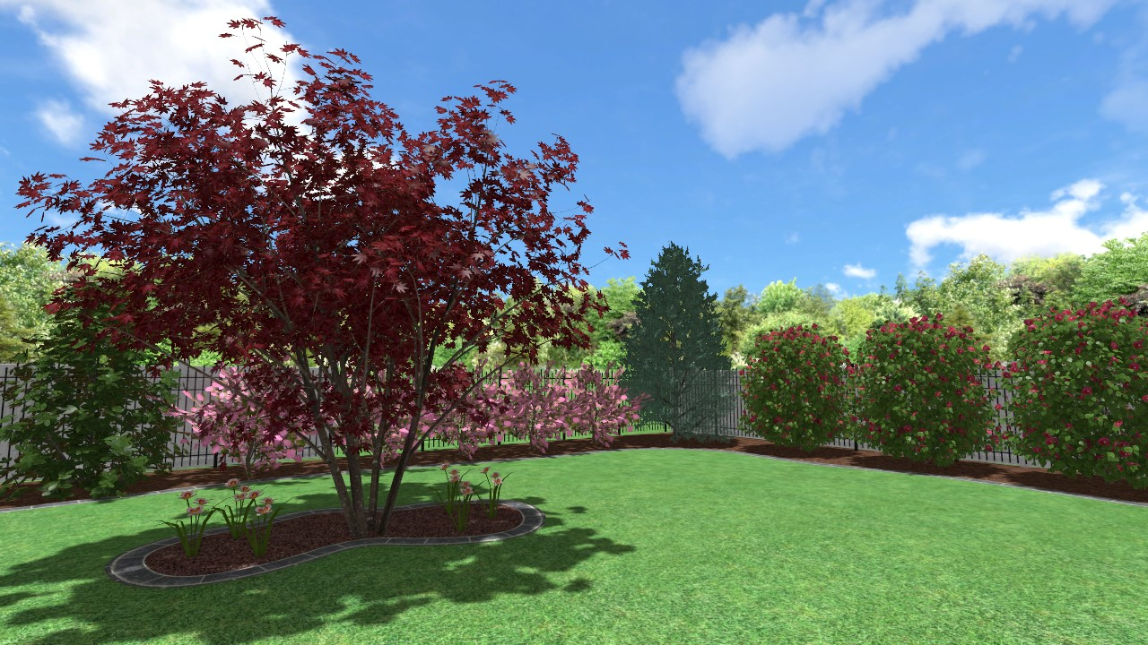

Slide 22
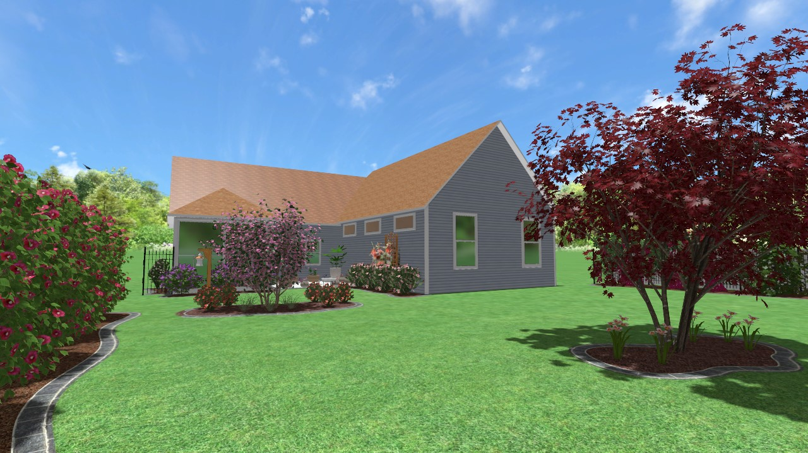

Slide 23
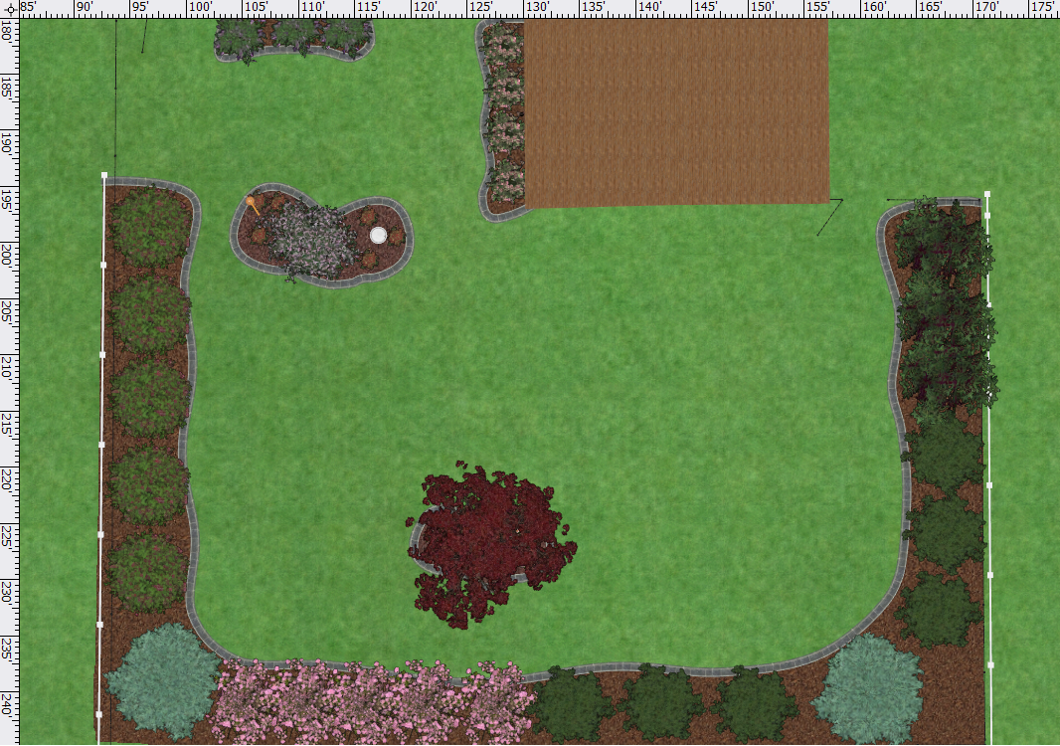
Top Down Backyard View #1
Blue Chip Butterfly Bush (3)
Variegated Liriope (6) planted around tree
Pink Knockout Roses (4)
Pink Velour Crape Myrtle
Major Wheeler Honeysuckle Vine (Plant behind roses with Trellis)
Red Diamond Loropetalum(3)
Red Drift Roses (6)/3 on each side of tree
Yuletide Camellia (5)
Bloodgood Japanese Maple Tree/Pretty in Pink Daylily (6) planted around tree
Little Gem Magnolia (3)
Blue Ice Cypress (1)
Purple Diamond Loropetalum (5)
Little Gem Magnolia (3)
Blue Ice Cypress (1)

Slide 24
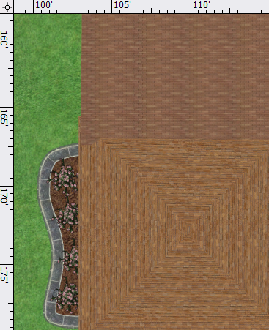
Top Down Backyard View #2
Purple Pillar Rose of Sharon (4)

